Slide 1
Monaco
Auto generate LCR file
Notes:
Title Slide

Slide 2
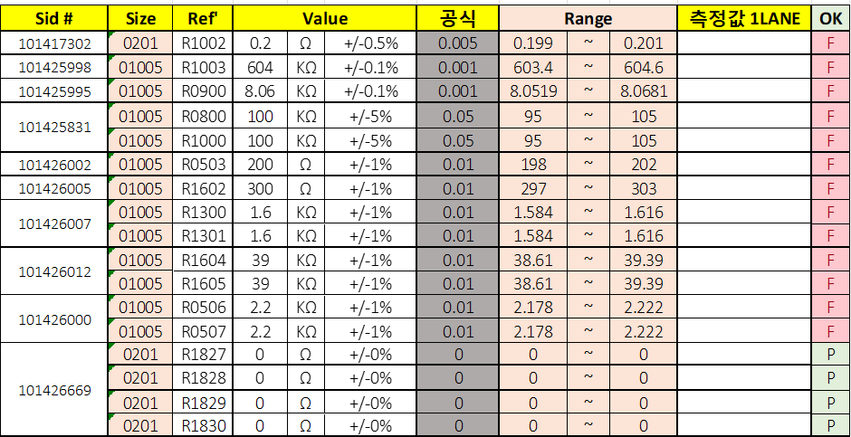
LCR
BOM
Format
MFG have to compare and gather data one by one row then input to format file

Slide 3
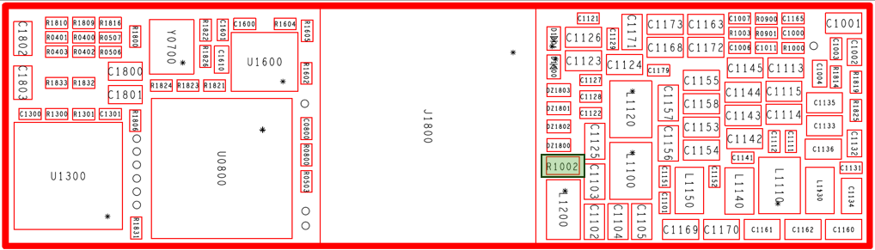
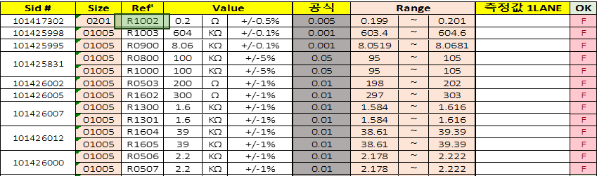
LCR improvement
Map
Format
Generate a software include “map” & “ format”
- when click to the location, it will appear on the map
- MFG can input data on “Format” area

Slide 4
LCR improvement procedure
Login → Input Badge number
Import BOM file
Generate Format & Input data
MFG confirm (measure finished)
Send Approval link to QA
QA Approve
Upload data on database

